Slide 1

Software development project Of Connect4 game with AI
Submitted By:
Sabiha Islam-1604070
Maruf Hasan-1604089
Supervised By:
Dr. Md. Iqbal Hasan Sarker
Assistant Professor
Animesh Chandra Roy
Assistant Professor
Md. Billal Hossain
Lecturer

Slide 2
Introduction
Used to describe machines (or computers) that mimic "cognitive" functions that humans associate with the human mind, such as "learning" and "problem solving".
Build board game Connect4 which is a vast area of AI.

Slide 3
Objectives
Human v/s human game plot
Human v/s AI game plot
Level of AI

Slide 4
Related works
Different approaches of online-adaptable learning rates like Incremental Delta Bar Delta (IDBD) or temporal coherence learning (TCL) whether having the potential
to speed up learning for such a complex task.
Propose a new variant of TCL with geometric step size changes.
Difficulty in human win by using VICTOR.

Slide 5
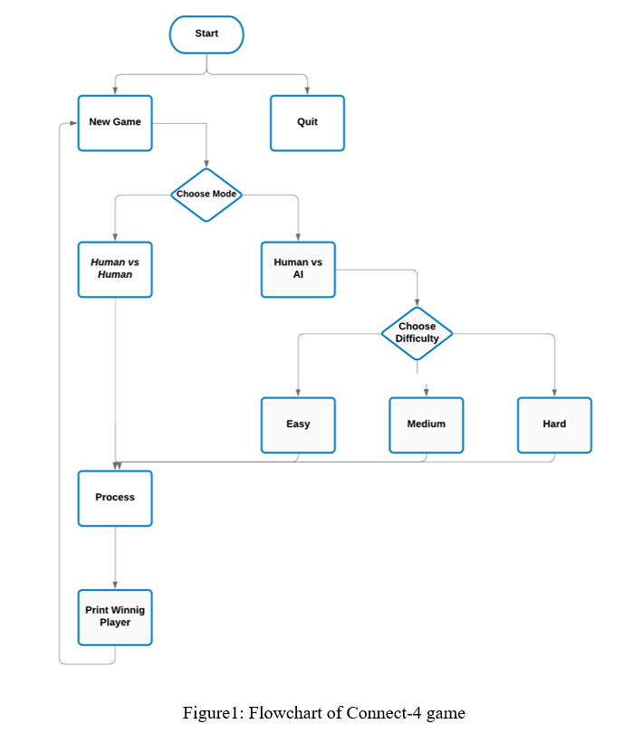
Methodology

Slide 6
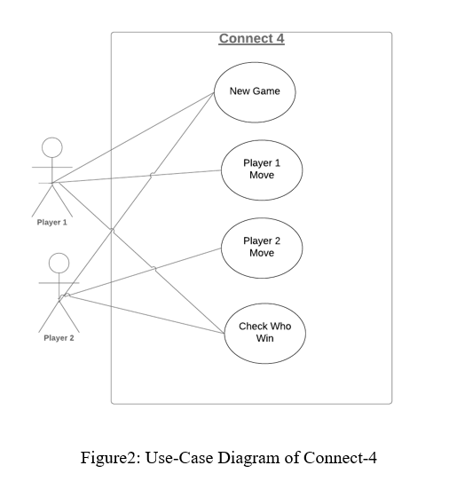
Methodology(Cont.)

Slide 7
Implementation
Platform for this game: Sublime Text Editor, Anaconda
Language: Python
Package needed: pygame, NumPy, math
PC Configuration: Any PC that could be installed Linux, Windows or other operating system. Also a dual core Pentium 4 or AMD A4/6 processor with minimum 2GB of RAM would be enough.

Slide 8
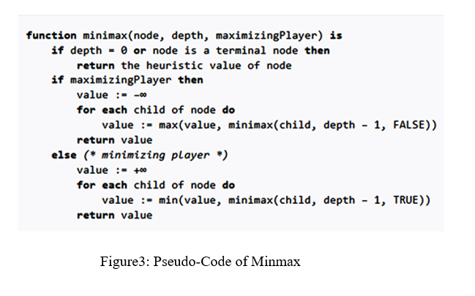
Implementation(Cont.)

Slide 9
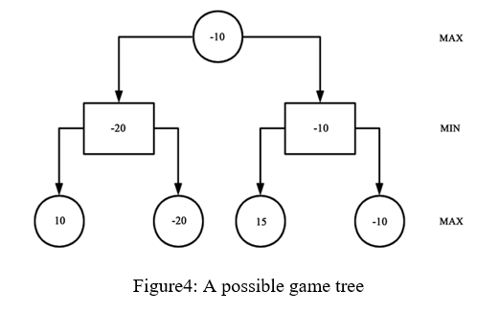
Implementation(Cont.)

Slide 10
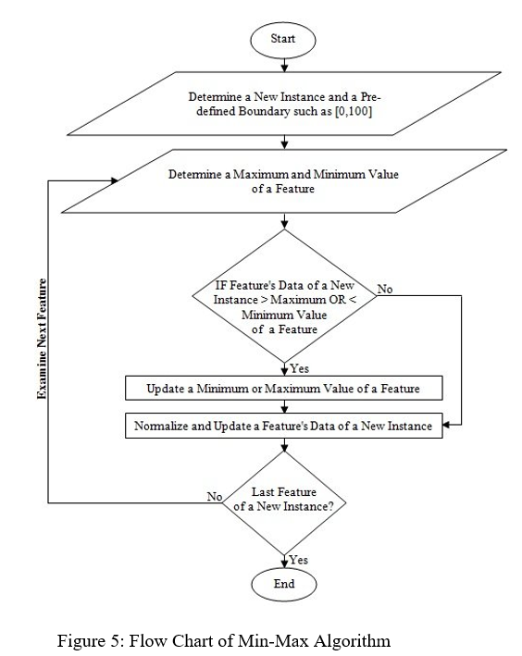
Implementation(Cont.)

Slide 11
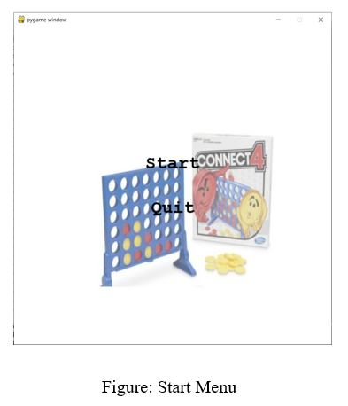
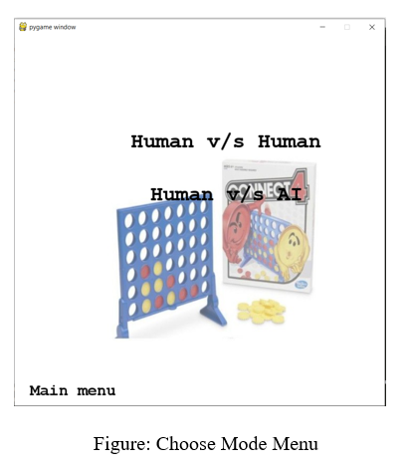
Result & Output

Slide 12
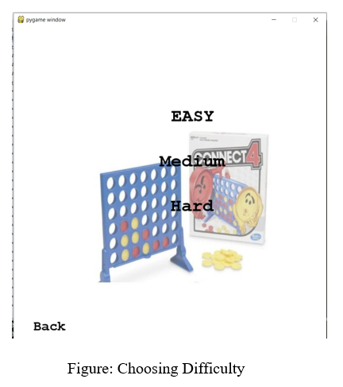
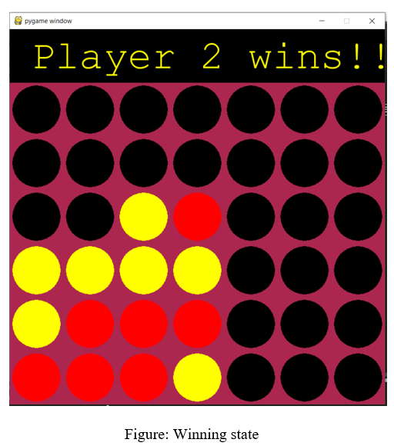
Result & Output(Cont.)

Slide 13
Limitations
Not android application based game
Can only run in project environment
Player moves slow
Board size of the game fixed(6x7)

Slide 14
Conclusion
Gather knowledge about AI & board game.
Try to solve the limitations in future.
Know about different types of algorithms.
Know about Python programming language.

Slide 15


Slide 16


